Slide 1
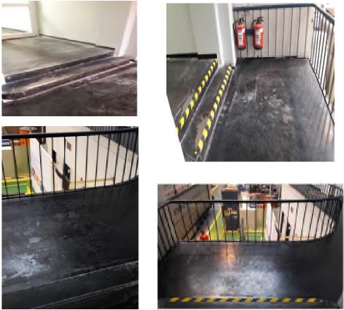
HS&E INCIDENT BULLETIN |  | 2nd half year 2016
Duisburg, Germany | Type of incident (Shoulder Fracture – Slip, Trip and Fall )
Summary: | Situation before Situation after
The incident occurred in building 40, 1st floor. The employee came out of the direction of hall 45 through the door toward the gallery leading to hall 44. After going through the door, he failed to see two steps just behind the door. As a result, he stumbled and fell against the railing with his shoulder. The impact broke his shoulder. He could haven fallen over the handrail.
Root Causes: | Actions Taken Thus Far: Next Steps
Multifocal Spectacles: People wearing bifocals/multifocal sometimes have difficulties with seeing. Stairs: No handrail (not required for 2-step stairs). Floor: Slight unevenness of the surface. Visibility of stairs: The edges of the steps are not highlighted or marked. Ruled out during investigation: Unknown walkway. Employee distracted or in a rush. Interaction of friction between shoes and floor. | Multifocal Spectacles: Developed an informational handout for employees getting multifocal glasses. Developed a safety moment on the use of multifocal spectacles. Floor/Stairs: Reviewed legal requirements regarding dimensions of stairs. Checked the surface of the floor. Highlighted the edge of the steps. Handrail shall be installed even though not legally required. Preventive measures: Identify and check other risk areas with 2 steps.

